Slide 1

Regular Expression with Python

Slide 2

Priti P.Bokariya,
Lecturer,CSE Department,
SBMP.
Modified By,
M.R.Solanki

Slide 3
Regular Expression
Regular Expressions, often shortened as regex, are a sequence of characters used to check whether a pattern exists in a given text (string) or not.
Example:
^a...s$
The above code defines a RegEx pattern. The pattern is: any five letter string starting with a and ending with s.

Slide 4
Applications
search and replace tools of word processors and text editors.
Used at the server side to validate the format of email addresses or passwords during registration.
Used for parsing text data files to find, replace, or delete certain string, etc.
Helps in manipulating textual data, in data science projects involving text mining.

Slide 5
Let’s start with Regular Expressions

Slide 6
Regular Expressions
Regular expressions are supported by the re module. So We have to import re module.
The re.match() function is used to search pattern within the test_string. The method returns a match object if the search is successful. If not, it returns None.
import re
pattern = '^a...s$'
test_string = 'abyss'
result = re.match(pattern, test_string)
if result:
print("Search successful.")
else:
print("Search unsuccessful.")
Search successful.

Slide 7
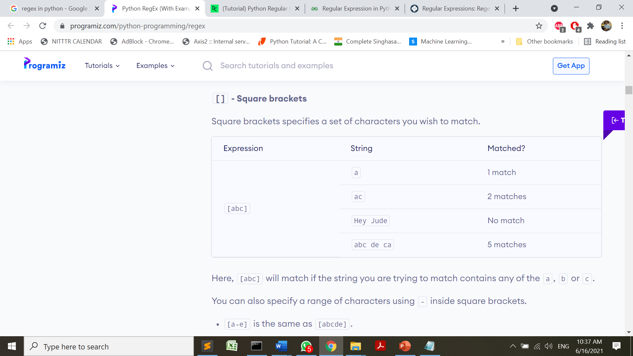
Meta Characters
To specify regular expressions, metacharacters are used.
Examples: [] . ^ $ * + ? {} () \ |

Slide 8
Meta Characters
We can also specify a range of characters using - inside square brackets.
[a-e] is the same as [abcde].
[1-4] is the same as [1234].
[0-39] is the same as [01239].
We can complement (invert) the character set by using caret ^ symbol at the start of a square-bracket.
[^abc] means any character except a or b or c.
[^0-9] means any non-digit character.

Slide 9
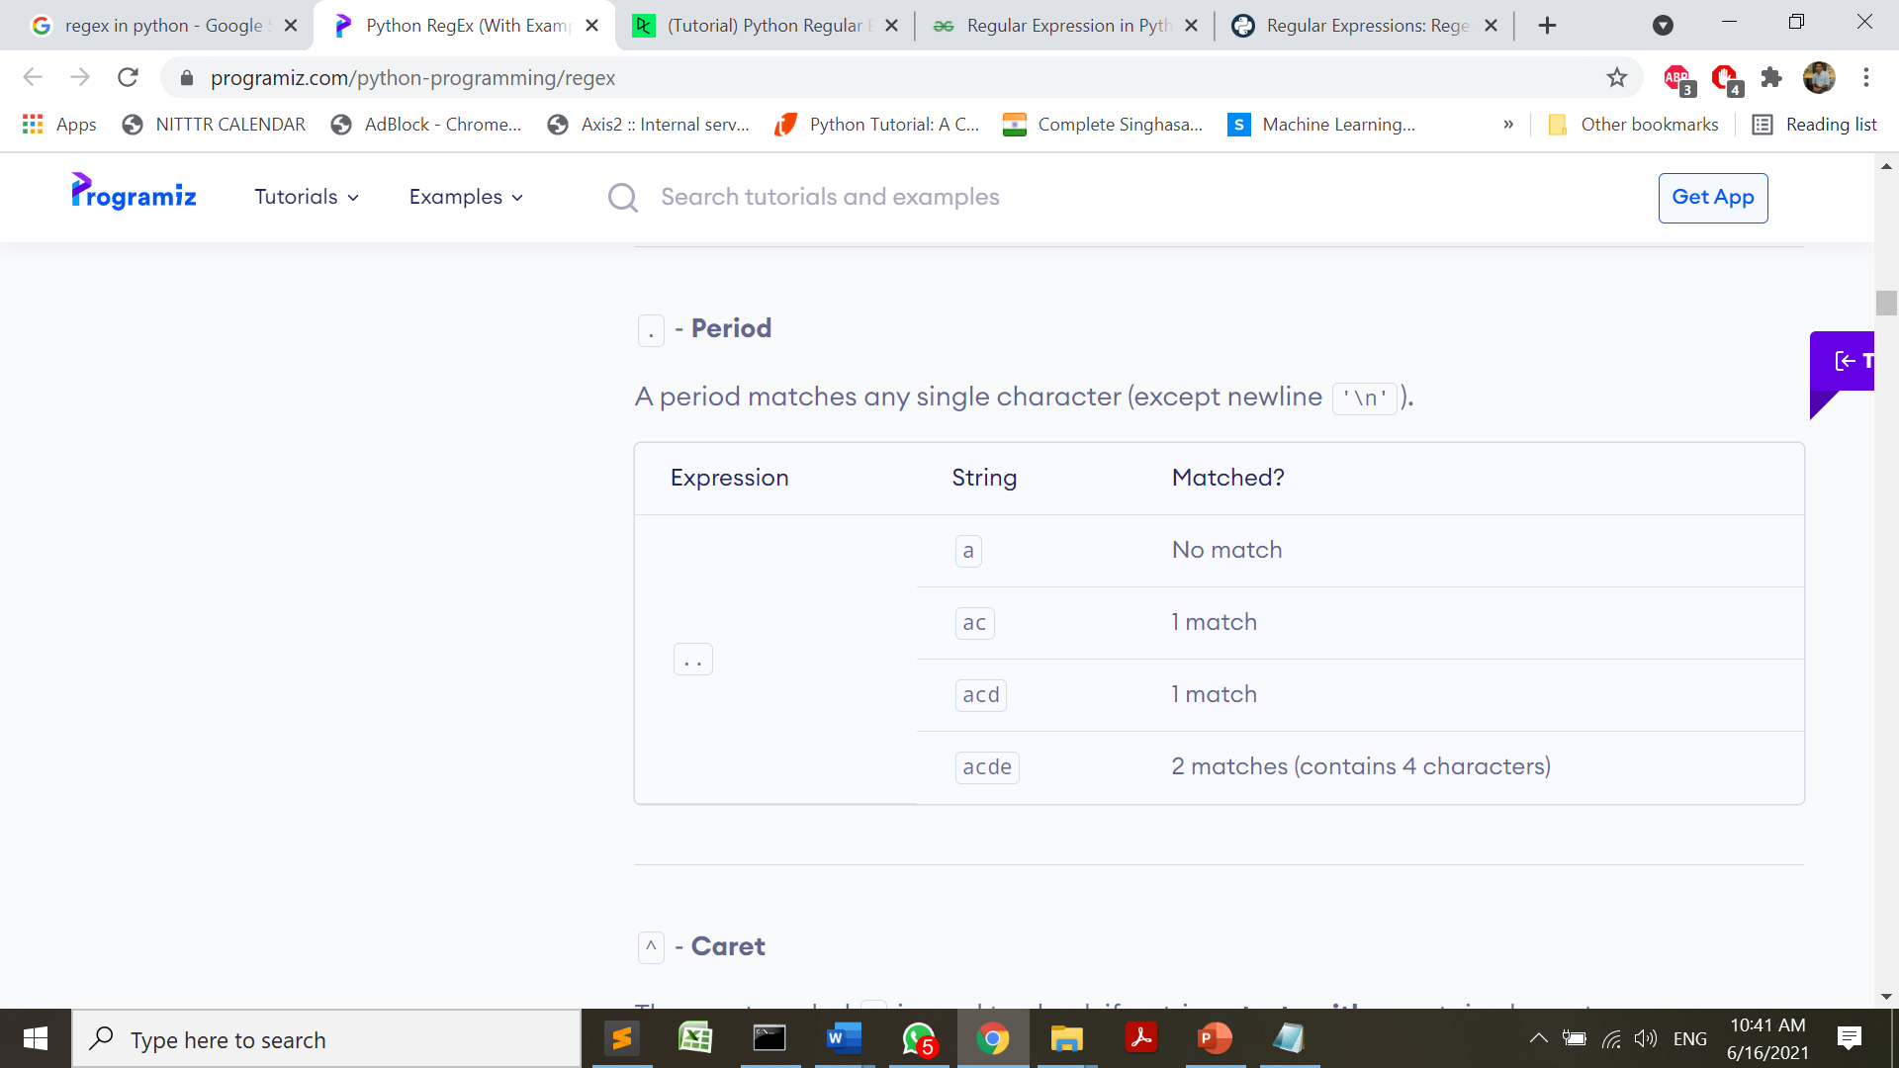
Meta Characters
To specify regular expressions, metacharacters are used.
Examples: [] . ^ $ * + ? {} () \ |

Slide 10
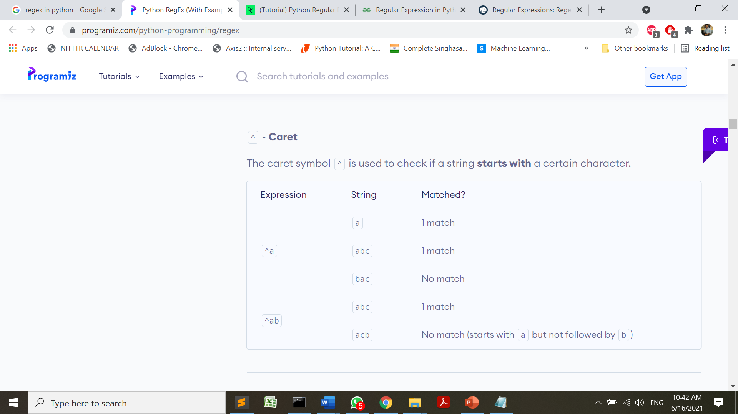
Meta Characters
To specify regular expressions, metacharacters are used.
Examples: [] . ^ $ * + ? {} () \ |

Slide 11
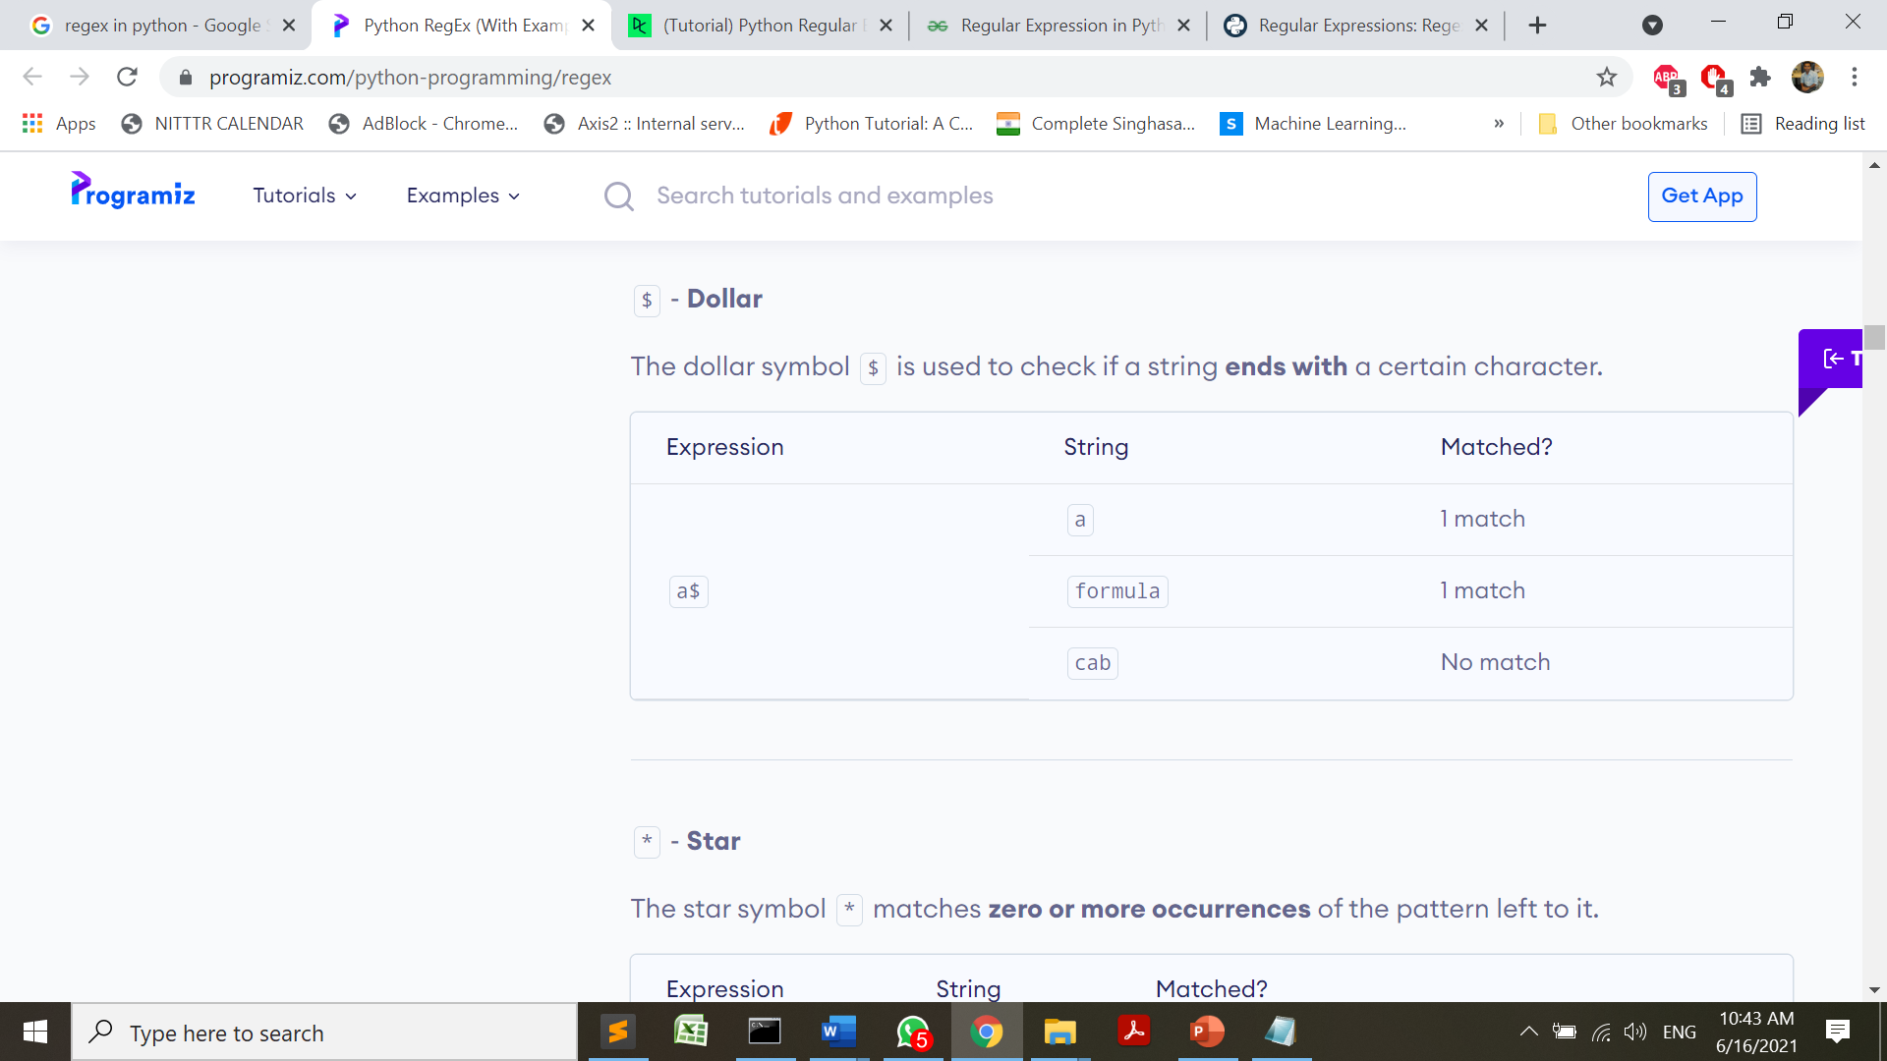
Meta Characters
To specify regular expressions, metacharacters are used.
Examples: [] . ^ $ * + ? {} () \ |

Slide 12
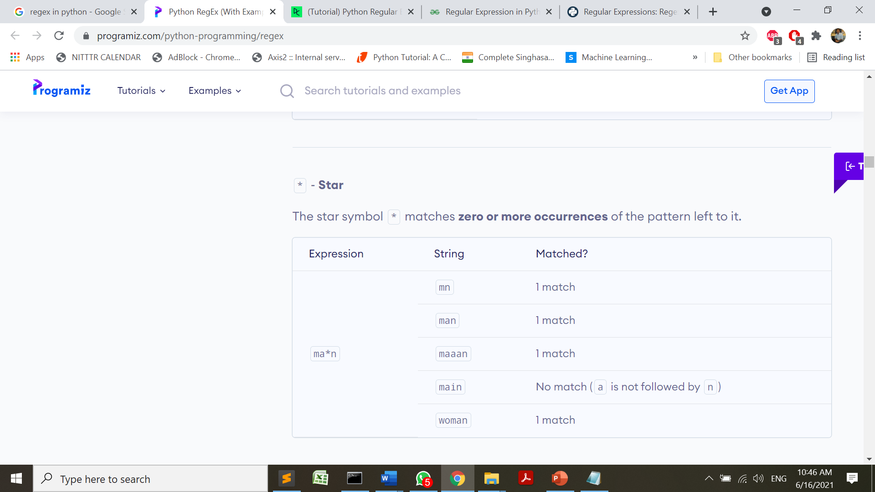
Meta Characters
To specify regular expressions, metacharacters are used.
Examples: [] . ^ $ * + ? {} () \ |

Slide 13
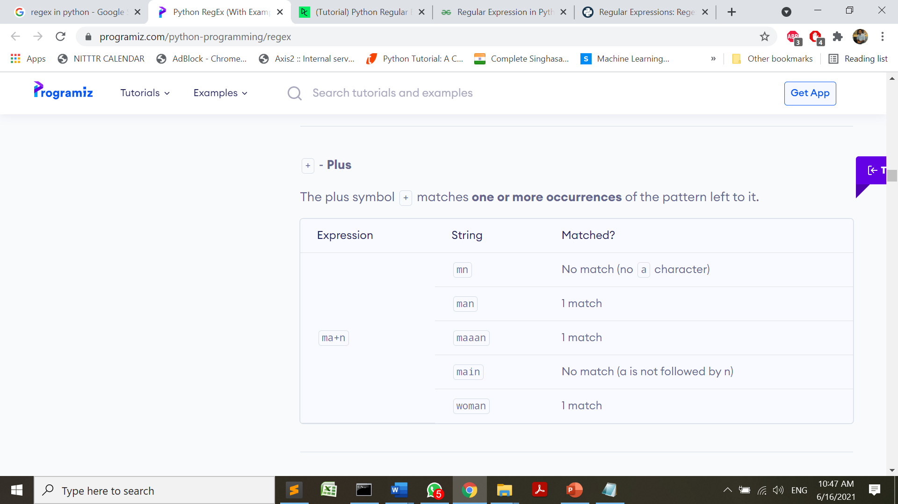
Meta Characters
To specify regular expressions, metacharacters are used.
Examples: [] . ^ $ * + ? {} () \ |

Slide 14
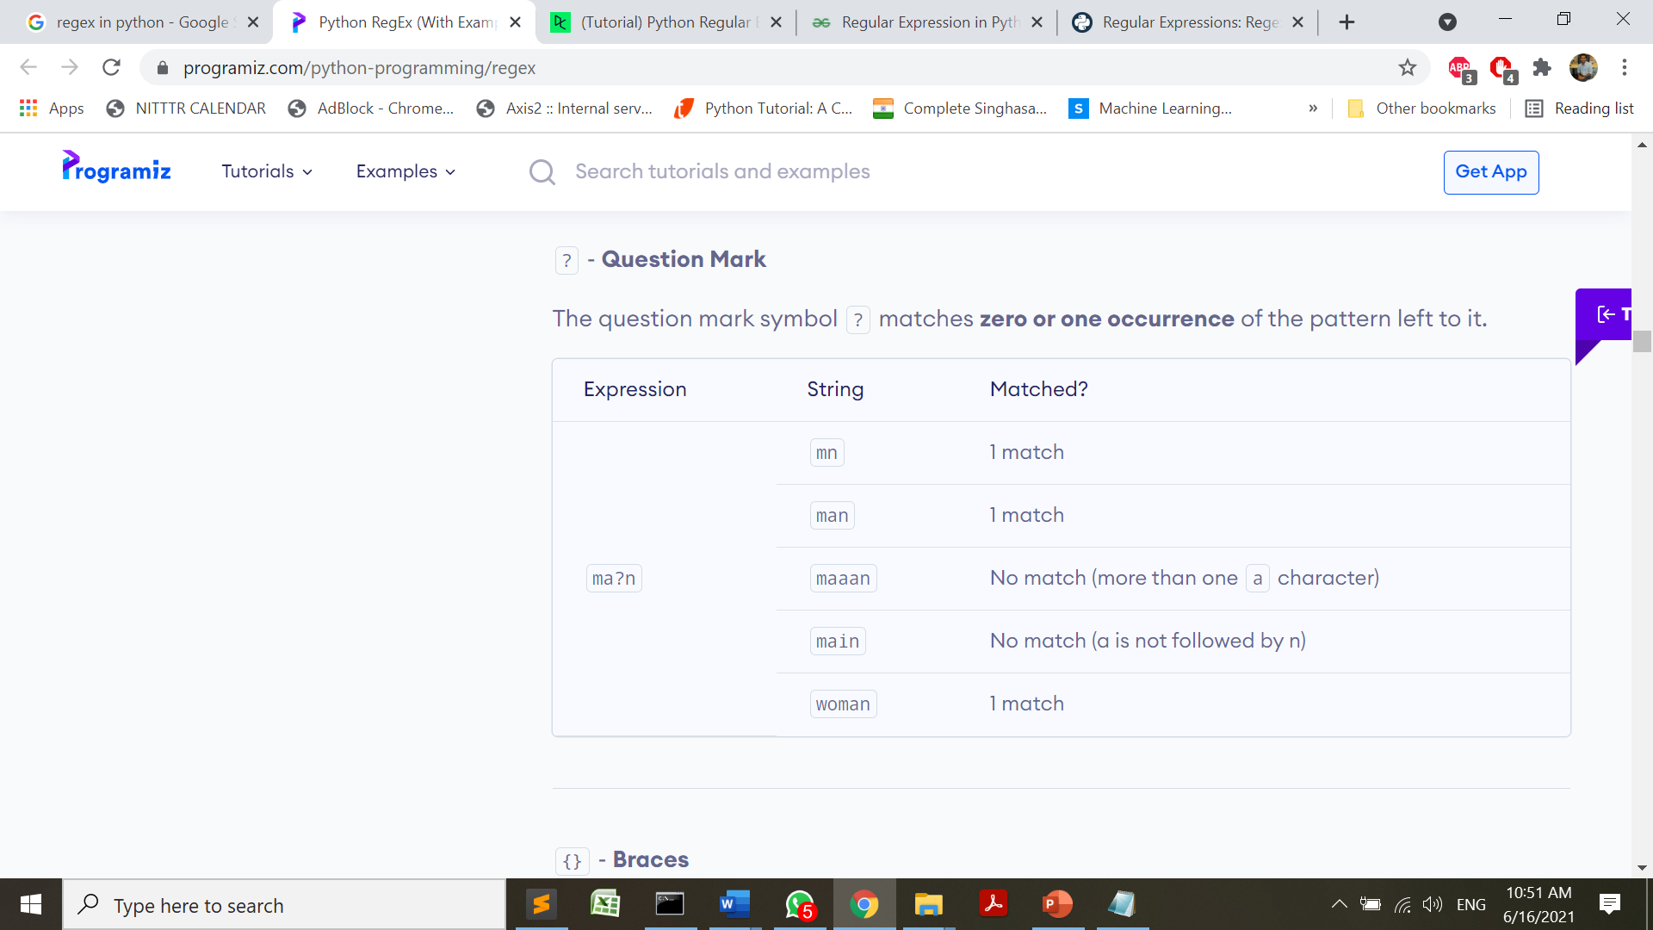
Meta Characters
To specify regular expressions, metacharacters are used.
Examples: [] . ^ $ * + ? {} () \ |

Slide 15
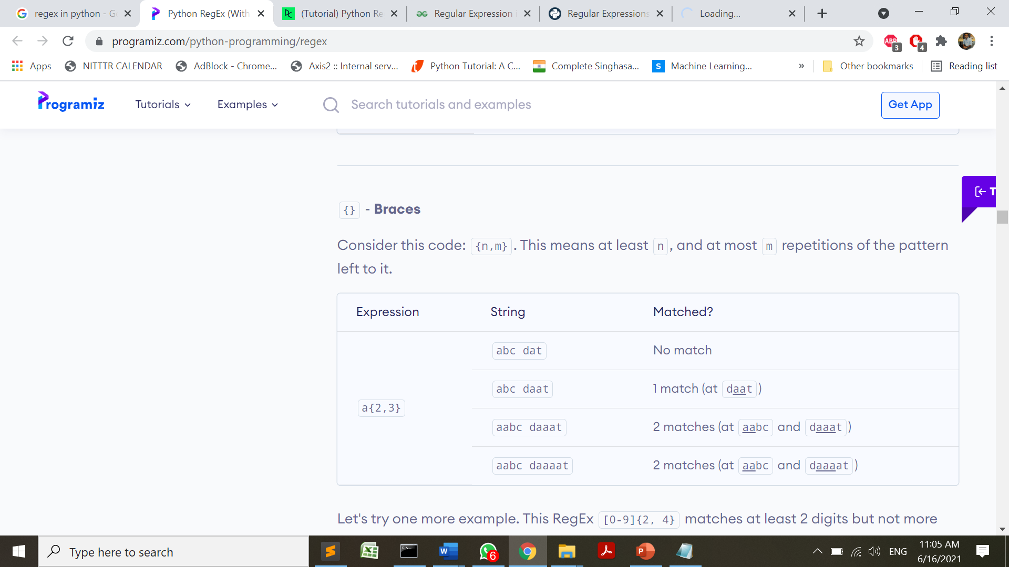
Meta Characters
To specify regular expressions, metacharacters are used.
Examples: [] . ^ $ * + ? {} () \ |

Slide 16
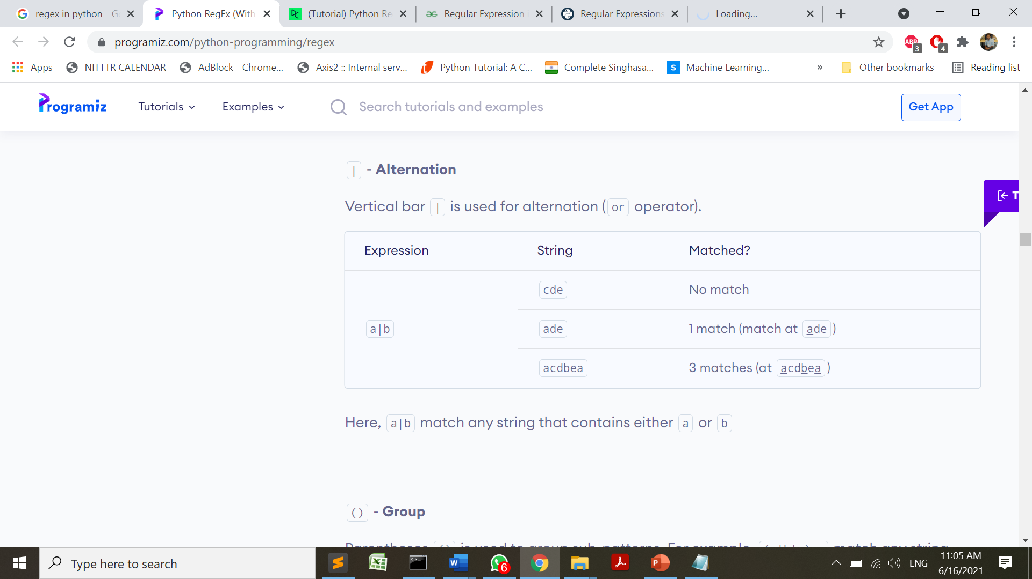
Meta Characters
To specify regular expressions, metacharacters are used.
Examples: [] . ^ $ * + ? {} () \ |

Slide 17

Meta Characters
To specify regular expressions, metacharacters are used.
Examples: [] . ^ $ * + ? {} () \ |

Slide 18
RegEx Functions
The re module offers a set of functions that allows us to search a string for a match:
Function | Description
findall | Returns a list containing all matches findall() module is used to search for “all” occurrences that match a given pattern
search | Returns a Match object if there is a match anywhere in the string. search() module will only return the first occurrence that matches the specified pattern
split | Returns a list where the string has been split at each match
sub | Replaces one or many matches with a string

Slide 19
match() | match() function of re in Python will search the regular expression pattern and return the first occurrence. The Python RegEx Match method checks for a match only at the beginning of the string. So, if a match is found in the first line, it returns the match object. But if a match is found in some other line, the Python RegEx Match function returns null
finditer() | Return an iterator yielding MatchObject instances over all non-overlapping matches for the RE pattern in string. The string is scanned left-to-right, and matches are returned in the order found.

Slide 20
findall(): The findall() function returns a list containing all matches.
import re
#Return a list containing every occurrence of "there":
txt = "where there is a will there is a way"
x = re.findall("there", txt)
print(x)
OUTPUT:
['there', 'there']

Slide 21
import re
txt = "India is a Great country"
#Find all lower case characters alphabetically between "a" and "e":
x = re.findall("[a-e]", txt)
print(x)
Output:
['d', 'a', 'a', 'e', 'a', 'c’]

Slide 22
import re
txt = "That will be 590 Rupees"
#Find all digit characters:
x = re.findall("\d", txt)
print(x)
Output:
['5', '9', '0']
<return slide>

Slide 23
import re
txt = "hello world"
#Search for a sequence that starts with "he", followed by two (any) characters, and an "o":
x = re.findall("he..o", txt)
print(x)
Output:
['hello’]
<return slide>

Slide 24
Program 1
import re
txt = "python programmers"
x = re.findall("^python", txt)
print(x)
if x:
print("Yes, the string starts with 'python'")
else:
print("No match")
OUTPUT:
['python']
Yes, the string starts with 'python'
>>>
Program 2
import re
txt = "python programmers"
x = re.findall("^Python", txt)
print(x)
if x:
print("Yes, the string starts with 'python'")
else:
print("No match")
OUTPUT:
[]
No match
<return slide>

Slide 25
import re
txt = "python programmers"
x = re.findall("programmers$", txt)
print(x)
if x:
print("Yes, the string ends with 'programmers'")
else:
print("No match")
OUTPUT:
['programmers']
Yes, the string ends with 'programmers'
<return slide>

Slide 26
import re
txt = "The rain in Spain falls mainly in the plain!"
x = re.findall("aix*", txt)
print(x)
if x:
print("Yes, there is at least one match!")
else:
print("No match")
OUTPUT:
['ai', 'ai', 'ai', 'ai']
Yes, there is at least one match!
<return slide>

Slide 27
import re
txt = "The rain in Spain falls mainly in the plain!"
#Check if the string contains "ai" followed by 1 or more "x" characters:
x = re.findall("aix+", txt)
print(x)
if x:
print("Yes, there is at least one match!")
else:
print("No match")
OUTPUT:
[]
No match
<return slide>

Slide 28
import re
txt = "The rain in Spain falls mainly in the plain!"
#Check if the string contains "a" followed by exactly two "l" characters:
x = re.findall("al{2}", txt)
print(x)
if x:
print("Yes, there is at least one match!")
else:
print("No match")
OUTPUT:
['all']
Yes, there is at least one match!
<return slide>

Slide 29
import re
txt = "In Python code, a string is a sequence of Unicode characters"
#Check if the string contains either “code" or “char":
x = re.findall("code|char", txt)
print(x)
if x:
print("Yes, there is at least one match!")
else:
print("No match")
OUTPUT:
['code', 'code', 'char']
Yes, there is at least one match!

Slide 30
The search() Function: The search() function searches the string for a match, and returns a Match object if there is a match.
If there is more than one match, only the first occurrence of the match will be returned:
import re
txt = "I use Python Prog"
x = re.search(“ ", txt) #search the white space in the txt
print(x)
print("The first white-space character is located in position:", x.start())
OUTPUT: <re.Match object; span=(1, 2), match=' '>
The first white-space character is located in position: 1

Slide 31
The split() Function:The split() function returns a list where the string has been split at each match:
import re
#Split the string at every white-space character:
txt = "I like programming in Python"
x = re.split(" ", txt) #x=re.split(“/s”,txt)
print(x)
OUTPUT:
['I', 'like', 'programming', 'in', 'Python']

Slide 32
You can control the number of occurrences by specifying the maxsplit parameter:
import re
#Split the string at the first occurrence only:
txt = "I like programming in Python"
x = re.split(" ", txt,1) #x=re.split(“/s”,txt,1)
print(x)
OUTPUT:
['I', 'like programming in Python’]

Slide 33
sub() Function: The sub() function replaces the matches with the text of your choice:
import re
txt = "I like programming in Python"
x = re.sub(" ","*",txt)
#white spaces will be replaced *
print(x)
OUTPUT:
I*like*programming*in*Python

Slide 34
Metacharacters are characters with special meaning
Character | Description | Example(hyperlinks to slides with programs)
[ ] | The set of characters | “[a-e]”
\ | Signals a special sequence (can also be used to escape special characters) | "\d"
. | Any character (except newline character) | "he..o"
^ | Starts with | "^python"
$ | Ends with | “programmers$"
* | Zero or more occurrences | "aix*"
+ | One or more occurrences | "aix+"

Slide 35
{} | Exactly the specified number of occurrences | "al{2}"
| | Either or | “code|char"
? | matches 0 or 1

Slide 36
Special Sequences
A special sequence is a \ followed by one of the characters in the list below, and has a special meaning:
Character | Description | Example
\A | Returns a match if the specified characters are at the beginning of the string | "\A"
\b | Returns a match where the specified characters are at the beginning or at the end of a word (the "r" in the beginning is making sure that the string is being treated as a "raw string") | “\bx” - at the beginning “y\b” - at the end
\B | Returns a match where the specified characters are present, but NOT at the beginning (or at the end) of a word (the "r" in the beginning is making sure that the string is being treated as a "raw string") | “\B”
\Z | Returns a match if the specified characters are at the end of the string | “abc\Z”

Slide 37
\d | Returns a match where the string contains digits (numbers from 0-9) | “\d”
\D | Returns a match where the string DOES NOT contain digits | “\D”
\s | Returns a match where the string contains a white space character | “\s”
\S | Returns a match where the string DOES NOT contain a white space character | “\S”
\w | Returns a match where the string contains any word characters (characters from a to Z, digits from 0-9, and the underscore _ character) | “\w”
\W | Returns a match where the string DOES NOT contain any word characters | “\W”

Slide 38
import re
txt = "Unicode was introduced to include every character in all languages and bring uniformity in encoding"
#Check if “Unicode" is present at the beginning of a word:
x = re.findall("\AUnicode", txt)
print(x)
if x:
print("Yes, there is at least one match!")
else:
print("No match")
OUTPUT:
['Unicode']
Yes, there is at least one match!
<slide 19>

Slide 39
import re
txt = "In every country "
#Check if “In" is present at the beginning of a WORD:
x = re.findall(r"\bIn", txt)
print(x)
if x:
print("Yes, there is at least one match!")
else:
print("No match")
OUTPUT:
['In']
Yes, there is at least one match!
<slide 19>

Slide 40
import re
txt = "Unicode was introduced to include every character in all languages and bring uniformity in encoding"
#Check if "cod" is present, but NOT at the beginning of a word:
x = re.findall(r"\Bcod", txt)
print(x)
if x:
print("Yes, there is at least one match!")
else:
print("No match")
OUTPUT:
['cod', 'cod']
Yes, there is at least one match!
<return to slide 19>

Slide 41
import re
txt = "In every country"
#Check if “country" is present at the end of a WORD:
x = re.findall("country\Z", txt)
print(x)
if x:
print("Yes, there is at least one match!")
else:
print("No match")
OUTPUT:
['country']
Yes, there is at least one match!
<slide 19>

Slide 42
import re
txt = "Pin code is 400053 "
x = re.findall("\d", txt)
print(x)
if x:
print("Yes, there is at least one match!")
else:
print("No match")
OUTPUT:
['4', '0', '0', '0', '5', '3']
Yes, there is at least one match!
<slide 20>
#Check if the string contains any digits (numbers from 0-9):
Note:
To get entire word, used “\d+”

Slide 43
import re
txt = "Pin code is 400053 "
#Return a match at every no-digit character: x = re.findall("\D", txt)
print(x)
if x:
print("Yes, there is at least one match!")
else:
print("No match")
OUTPUT:
['P', 'i', 'n', ' ', 'c', 'o', 'd', 'e', ' ', 'i', 's', ' ', ' ']
Yes, there is at least one match!
<slide 20>

Slide 44
import re
txt = "I am a Python Programmer“
#Return a match at every white-space character:
x = re.findall("\s", txt)
print(x)
if x:
print("Yes, there is at least one match!")
else:
print("No match")
OUTPUT:
[' ', ' ', ' ', ' ']
Yes, there is at least one match!
<slide 20>

Slide 45
import re
txt = "I am a Python Programmer"
#Return a match at every white-space character:
x = re.findall("\S", txt)
print(x)
if x:
print("Yes, there is at least one match!")
else:
print("No match")
OUTPUT:
['I', 'a', 'm', 'a', 'P', 'y', 't', 'h', 'o', 'n', 'P', 'r', 'o', 'g', 'r', 'a', 'm', 'm', 'e', 'r']
Yes, there is at least one match!
<slide 20>

Slide 46
import re
txt = "Python 3_9_2 installed"
#Return a match at every word character (characters from a to Z, digits from 0-9, and the underscore _ character):
x = re.findall("\w", txt)
print(x)
if x:
print("Yes, there is at least one match!")
else:
print("No match")
OUTPUT:
['P', 'y', 't', 'h', 'o', 'n', '3', '_', '9', '_', '2', 'i', 'n', 's', 't', 'a', 'l', 'l', 'e', 'd']
Yes, there is at least one match!
<slide 20>

Slide 47
import re
txt = "Why do like python as a Programming language?"
#Return a match at every NON word character (characters NOT between a and Z. Like "!", "?" white-space etc.):
x = re.findall("\W", txt)
print(x)
if x:
print("Yes, there is at least one match!")
else:
print("No match")
OUTPUT:
[' ', ' ', ' ', ' ', ' ', ' ', ' ', '?']
Yes, there is at least one match!

Slide 48
Sets
A set is a set of characters inside a pair of square brackets [] with a special meaning:
[pqr]→ Returns a match where one of the specified characters (p, q, or r) are present
[a-e]→ Returns a match where any lower case character alphabetically between a and e
[^aeiou]→
[0123]→Returns a match for any number of the specified digits 0,1,2,3 are present
[0-9]→Returns a match for any number from 0 to 9
[0-5][0-9]→ Returns a match for any two digits from 00 to 59
[a-zA-Z]→ Returns a match for any alphabet from a to z lowercase or Uppercase
Returns a match for any character EXCEPT a, e,i,o, and u

Slide 49
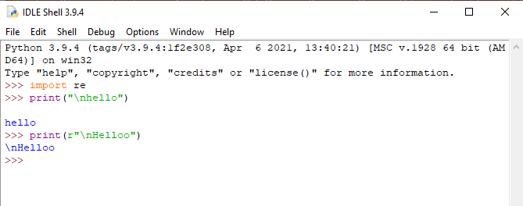
When an 'r' or 'R' prefix is present, a character following a backslash is included in the string without change, and all backslashes are left in the string.
For example, the string literal r"\n" consists of two characters: a backslash and a lowercase ‘n’
For example:
>>> import re
>>> print("\nhello")
hello
>>> print(r"\nHelloo")
\nHelloo
>>>

Slide 50
compile() method
Python’s re.compile() method is used to compile a regular expression pattern provided as a string into a regex pattern object (re.Pattern).
Later we can use this pattern object to search for a match inside different target strings using regex methods such as a re.match() or re.search().
Syntax: re.compile(pattern, flags=0)
pattern: regex pattern in string format, which you are trying to match inside the target string.
flags: The expression’s behavior can be modified by specifying regex flag values. This is an optional parameter.

Slide 51
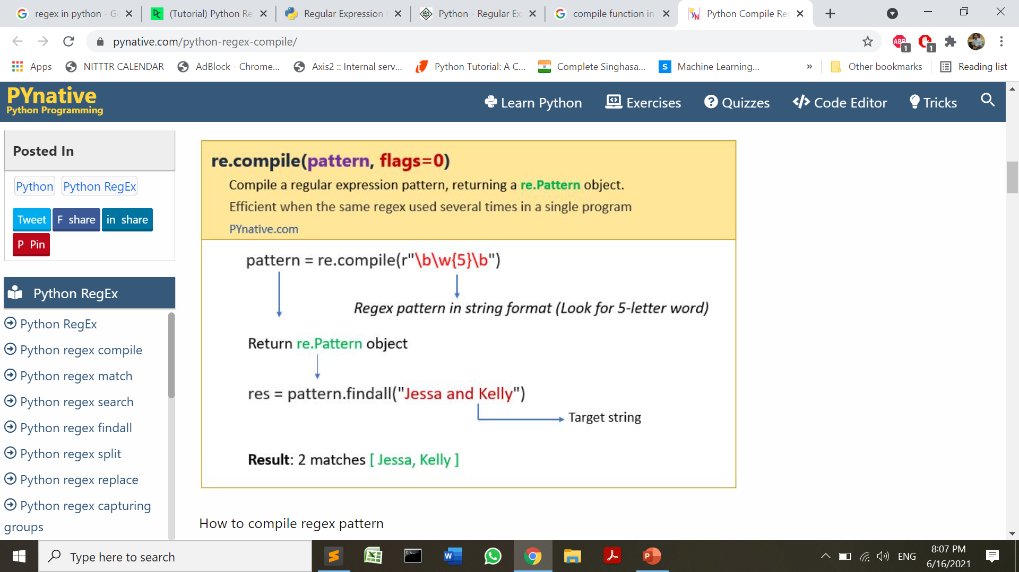
compile() method
https://pynative.com/python-regex-compile/

Slide 52
compile() method
import re
# Target String one
str1 = "Emma's luck numbers are 251 761 231 451"
# pattern to find three consecutive digits
string_pattern = r"\d{3}"
# compile string pattern to re.Pattern object
regex_pattern = re.compile(string_pattern)
# print the type of compiled pattern
print(type(regex_pattern))
# find all the matches in string one
result = regex_pattern.findall(str1)
print(result)
# Target String two
str2 = "Kelly's luck numbers are 111 212 415"
# find all the matches in second string by reusing the same pattern
result = regex_pattern.findall(str2)
print(result)
<class 're.Pattern'>
['251', '761', '231', '451']
['111', '212', '415']

Slide 53
Match Object
A Match Object is an object containing information about the search and the result.
import re
txt ="Unicode in coding"
x = re.search("cod",txt)
print(x)#this will print an object
OUTPUT:
<re.Match object; span=(3, 6), match='cod'>

Slide 54
Match Object
The Match object has properties and methods used to retrieve information about the search, and the result:
.span() →returns a tuple containing the start-, and end positions of the match.
.group() →returns the part of the string where there was a match
start()→returns the start position of the match
end()→ returns the end position of the match

Slide 55
Match Object
import re
txt = "123abc456789abc123ABC"
pattern = re.compile(r"abc") #it returns a code object
match=pattern.search(txt) #this returns a match object
print(pattern)
print(match)
OUTPUT:
re.compile('abc')
<re.Match object; span=(3, 6), match='abc'>

Slide 56
Match Object
group()
import re
txt = "Unicode in coding"
pattern = re.compile(r"\bcod")
match=pattern.search(txt)
print(match)
print(match.group())
OUTPUT:
<re.Match object; span=(11, 14), match='cod'>
cod

Slide 57
Match Object
span(), start() ,end()
import re
txt = "Unicode in coding"
pattern = re.compile(r"\bcod")
match=pattern.search(txt)
print(match)
print(match.span())
print(match.start())
print(match.end())
OUTPUT:
<re.Match object; span=(11, 14), match='cod’>
(11, 14)
11
14

Slide 58
Steps of Regular Expression Matching
While there are several steps to use regular expressions in Python, each step is fairly simple.
Import the regex module with import re.
Create a Regex object with the re.compile() function. (Remember to use a raw string.)
Pass the string you want to search into the Regex object’s search() method. This returns a Match object.
Call the Match object’s group() method to return a string of the actual matched text.
You may call span() or start() or end() method as per your requirement.

Slide 59
For Example
To creatre a regex object and call functions
import re
txt = "Unicode in coding "
pattern = re.compile(r"cod") #pattern is a regex object
matches=pattern.findall(txt) #instances of match object
for match in matches:
print(match)
cod
cod

Slide 60
finditer() method
The re.finditer() works exactly the same as the re.findall() method except it returns an iterator yielding match objects matching the regex pattern in a string instead of a list.
It scans the string from left-to-right, and matches are returned in the iterator form.
Later, we can use this iterator object to extract all matches.
Note: In simple words, finditer() returns an iterator over MatchObject objects.

Slide 61
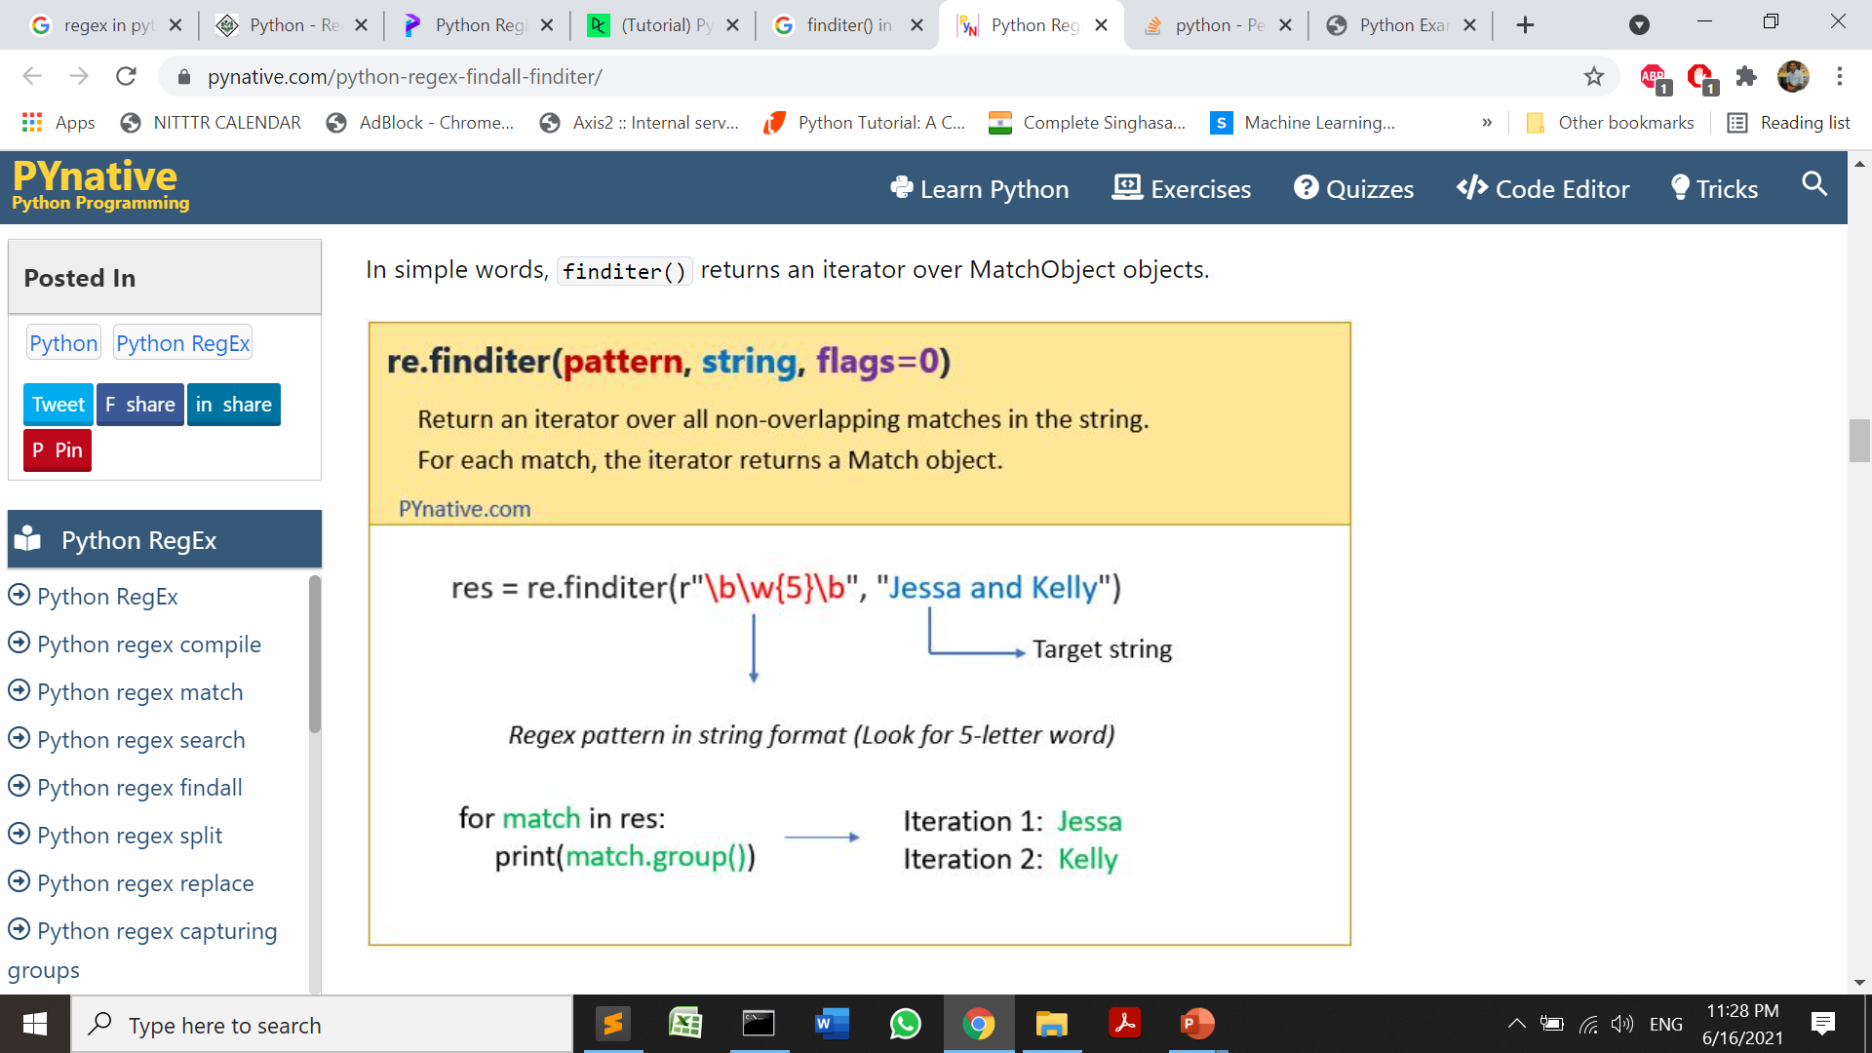
finditer() method

Slide 62
In some scenarios, the number of matches is high, and you could risk filling up your memory by loading them all using findall(). Instead of that using the finditer(), you can get all possible matches in the form of an iterator object, which will improve performance.
It means, finditer() returns a callable object which will load results in memory when called.

Slide 63
finditer can be invoked using the codeobject returned by compile method as follows
In the below program the pattern is a codeobject and matches is a iterable object for match instances returned .
PROGRAM 2
import re
txt = "Unicode in coding "
pattern = re.compile(r"cod")
matches=pattern.finditer(txt)
for match in matches:
print(match)
OUTPUT:
<re.Match object; span=(3, 6), match='cod'>
<re.Match object; span=(11, 14), match='cod'>
finditer()
PROGRAM 1
import re
txt= 'Unicode in coding'
pattern = 'cod'
matches=re.finditer(pattern, txt)
for match in matches:
print(match)
OUTPUT:
<re.Match object; span=(3, 6), match='cod'>
<re.Match object; span=(11, 14), match='cod'>

Slide 64
match()
import re
txt= 'Unicode in coding'
pattern='cod'
match=re.match(pattern,txt)
print(match)
OUTPUT:
None
import re
txt= 'Unicode in coding'
pattern=re.compile(r"Uni")
match=pattern.match(txt)
print(match)
OUTPUT:
<re.Match object; span=(0, 3), match='Uni'>
import re
txt= 'Unicode in coding'
pattern='Uni'
match=re.match(pattern,txt)
print(match)
OUTPUT:
<re.Match object; span=(0, 3), match='Uni’>
Match function matches the pattern only at the starting of the string and for one occurrence only

Slide 65
Pattern matching in Python

Slide 66
For example, a \d in a regex stands for a digit character — that is, any single numeral 0 to 9.
Following regex is used in Python to match a string of 10 numbers .To check if the phone number is of 10 digits.
The regex is: \d\d\d\d\d\d\d\d\d\d
It can also be written as \d{10}
quantifier {} with a value 10 means 10 times occurrence of a digit

Slide 67
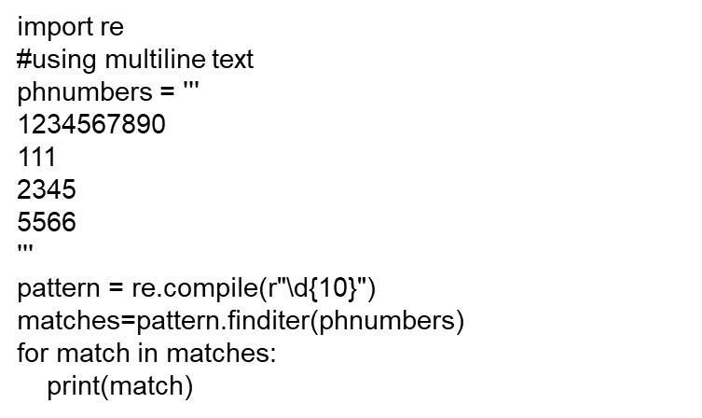
Program 1
import re
phnumbers = ‘’’ #using multiline text
1234567890
111
2345
5566
'''
pattern = re.compile(r"\d\d\d\d\d\d\d\d\d\d")
matches=pattern.finditer(phnumbers)
for match in matches:
print(match)
OUTPUT:
<re.Match object; span=(1, 11), match='1234567890'>

Slide 68
Grouping with parentheses

Slide 69
Suppose we want to separate the area code from the subscriber number that can be done using parenthesis .
(\d\d\d)-(\d\d\d-\d\d\d\d) is the regex for the same
import re
phoneNumRegex = re.compile(r'(\d\d\d)-(\d\d\d-\d\d\d\d)')
mo = phoneNumRegex.search('My number is 415-555-4242.')
print(mo.group(0))
print(mo.group(1))
print(mo.group(2))
OUTPUT:
415-555-4242
415
555-4242

Slide 70
To display the date of the format yyyy.mm.dd
Regular expression will be
(\d\d\d\d)\.(\d\d)\.(\d\d)
to take the dot(.) as it is, backslash(\) should be used ,otherwise it will be treated as meta character

Slide 71
Program 3
import re
dates='''
01.05.2021
2021.04.23
2021.05.21
2021.05.22
2021.05.23
2021.05.26
2021/04/23
2021_04_20
2021_04_09
'''
date = re.compile(r'(\d\d\d\d)\.(\d\d)\.(\d\d)')
mo = date.finditer(dates)
for m in mo:
print(m.group(0))
OUTPUT:
2021.04.23
2021.05.21
2021.05.22
2021.05.23
2021.05.26

Slide 72
To display the date yyyyddmm separated by underscore(_) or slash (/)
Regular expression (\d\d\d\d) [ _/](\d\d)[ _/](\d\d)
Use of set to have occurrence of underscore or slash[ _/]

Slide 73
Program 4
import re
dates='''
01.05.2021
2021.04.23
2021.05.21
2021.05.22
2021.05.23
2021.05.26
2021/04/23
2021_04_20
2021_04_09
'''
date = re.compile(r'(\d\d\d\d)[_/](\d\d)[_/](\d\d)')
mo = date.finditer(dates)
for m in mo:
print(m.group(0))
OUTPUT:
2021/04/23
2021_04_20
2021_04_09

Slide 74
To display the date yyyymmdd separated by underscore(_) or slash (/) of the month April (04) and May(05)
Regular expression (\d\d\d\d)[ _/](0[4|5])[ _/](\d\d)
(zero common[set either 4 or 5 ])

Slide 75
Program 5
import re
dates='''
01.05.2021
2021.04.23
2021.05.21
2021.05.22
2021.05.23
2021.05.26
2021/04/23
2021_05_20
2021_06_09
'''
date = re.compile(r'(\d\d\d\d)[_/](0[4|5])[_/](\d\d)')
mo = date.finditer(dates)
for m in mo:
print(m.group(0))
OUTPUT:
2021/04/23
2021_05_20

Slide 76
Program 6: To display the name with the tag Mr.
import re
names='''
Mr. Rathi
Mrs. Rathi
Mr Sukhi
Ms Sukhi
Mr. Lovely
'''
nm = re.compile(r'Mr\.\s\w+')
matches = nm.finditer(names)
for m in matches:
print(m.group(0))
OUTPUT:
Mr. Rathi
Mr. Lovely
Regex : Mr\.\s\w+
Mr followed by dot(\.) followed by space(\s) followed by one or more occurences of characters (\w+)
+ indicates 1 or more

Slide 77
Program 7: To display the name with the tag Mr
Regex: Mr\.?\s\w+
Here the dot is made optional as it is followed by ? (zero or more occurrence )
import re
names='''
Mr. Rathi
Mrs. Rathi
Mr Sukhi
Ms Sukhi
Mr. Lovely
'''
nm = re.compile(r'Mr\.?\s\w+')
matches = nm.finditer(names)
for m in matches:
print(m.group(0))
OUTPUT:
Mr. Rathi
Mr Sukhi
Mr. Lovely

Slide 78
Program 8: To check the valid email id out of the given email addreses
Regex for email id:
[a-zA-Z0-9]+@[a-z]+\.[a-z]+
one or more occurences
A set denoting useraddress
Lowercase uppercase alphanumeric characters domain name
eg com
Which may also include dot(.)
eg. pritibokariya
priti.bokariya
domain name
gmail

Slide 79
import re
email='''
Mr. Rathi
Mrs. Rathi
Mr Sukhi
Ms Sukhi
Mr. Lovely
pythonengineer@gmail.com
priti.bokariya@yahoo.com
pritibokariya22@rediffmail.com
'''
nm = re.compile(r'[a-zA-Z0-9._]+@[a-z]+\.[a-z]+')
matches = nm.finditer(email)
for m in matches:
print(m.group(0))
OUTPUT:
pythonengineer@gmail.com
priti.bokariya@yahoo.com
pritibokariya22@rediffmail.com

Slide 80
Grouping the email address using paranthesis
import re
email='''
pythonengineer@gmail.com
'''
nm = re.compile(r'([a-zA-Z0-9\.]+)@([a-z]+)(\.[a-z]+)')
matches = nm.finditer(email)
for m in matches:
print(m.group(0))
print(m.group(1))
print(m.group(2))
print(m.group(3))
OUTPUT:
pythonengineer@gmail.com
pythonengineer
gmail
.com

Slide 81
Validating Password
import re
count=0
passwords = ['Password1', 'password2', 'passwordthree', 'P4', 'mypassworD1!!!', '898*(*^$^@%&#abcdef']
for passwd in passwords:
dmo = re.search(r"\d",passwd)
if dmo:
count+=1
cmo = re.search(r"[A-Z]+",passwd)
if cmo:
count+=1
scmo=re.search(r"\w+\W+",passwd)
if scmo:
count+=1
if count==3:
print(passwd,"=>""OK")
else:
print(passwd,"=>","NOT OK")
count=0
Password1 => NOT OK
password2 => NOT OK
passwordthree => NOT OK
P4 => NOT OK
mypassworD1!!! =>OK
898*(*^$^@%&#abcdef => NOT OK

Slide 82
References
https://www.w3schools.com/python/python_regex.asp
https://www.tutorialspoint.com/python/python_reg_expressions.htm
https://www.guru99.com/python-regular-expressions-complete-tutorial.html
https://www.programiz.com/python-programming/regex
https://pynative.com/python-regex-compile/

